Slide 1
Fraud Analytics
DSO 562
Spring 2018

Slide 2
1/11 Class 1 - Overview
My background
What we’ll cover during the semester
Grading, homework, projects
What is fraud
How to build fraud algorithms
Tax fraud example
Assignment Homework 1

Slide 3
Who Am I
Stephen Coggeshall, PhD Nuclear Engineering
Worked 11 years at Los Alamos National Lab doing nuclear fusion research
Began doing machine learning in 1990
Cofounded three analytics companies
CASA (1995) -> HNC/FICO (2000)
Los Alamos Computational Group (2002) -> Morgan Stanley (2004)
ID Analytics (2002) -> LifeLock (2012) -> Symantec (2017)
Chief Analytics and Science Officer IDA, LifeLock, retired
Oversee technology, analytics for risk and marketing analytics
Taught Fraud Analytics USC 2016, 2017, UCSD 2017

Slide 4
Fraud Problems I’ve Worked On
IRS tax preparer fraud
Credit card transaction fraud
Credit card merchant fraud
Healthcare claims fraud and abuse
Identity fraud for
Financial services (credit cards, loans, payday loans…)
Telecommunications (Sprint, TMobile, ATT, Verizon…)
Government agencies (SSA, VA, IRS)

Slide 5
What We’ll Cover
What are the types of fraud, how is it committed
Principles in catching fraud
Various algorithmic approaches to fraud detection
You will work on 3 projects and build fraud algorithms, 1 unsupervised and 2 supervised fraud algorithms

Slide 6
Outline of Semester (Syllabus)

Slide 7
Survey room for background, skills, experience
What undergraduate degrees
What programming skills (SAS, R, Matlab, Python…)
What business experiences (jobs, internships…)

Slide 8
Define Fraud
Fraud:
A wrongful or criminal deception intended to result in financial or personal gain
Intentional misrepresentation in order to improperly receive something of value
Give Examples
For each, where/how does the problem happen
How big is the problem
Who pays for/is harmed by it

Slide 9
High Level Process for Building a Fraud Algorithm
Understand the nature of the problem
Gather and explore the data
Design overall modeling structure (inputs, outputs, training, testing, how will be evaluated, implemented)
Design and build variables (entities, profiles)
Select algorithm, train, test, finalize
Implement, monitor, improve
Use common sense all the time

Slide 10
First Fraud Problem: Tax Preparer Fraud
What is the business problem:
Find fraud committed by tax preparers, not necessarily tax payers
What was the situation when I took over the project:
Team building supervised fraud models looking for unusual tax returns
Using linear, logistic regressions, various clustering methods
Scored hundreds of thousand returns, sent few hundred to IRS to investigate
IRS kept saying “nothing there”
What would you do?

Slide 11
Look at data. What fields are available?
Name, address
Dependents
You and spouse SSN
Filing status
Income
Adjustments to income
Refund amount (+/-)
PTIN
EIN
Self employed
Preparer’s name
ABA routing number
Account number
Occupation
Date
Estimated tax penalty
Tax credits

Slide 12
Tax Preparer Fraud Solution Approach
First fully understand the business problem:
seeking tax preparer, not tax payer fraud
Fully understand current flagging and investigative process:
Investigators looking for connections between returns, all manual and in their heads
Simple solution:
Build a fraud score for each return
Aggregate summary information at the tax preparer level
Sort tax preparers by a summary fraud score and present summarized info to investigators in an efficient way

Slide 13
Homework 1: Examples of Fraud Due 1/18 noon
List 5 kinds of fraud, for each describe
Nature of the problem (industry, product…)
Size of the problem ($’s, volumes, importance…)
Who commits the fraud (individuals, groups, professionals…)
How the fraud is committed
Who is harmed? Who pays for the losses?
How is the problem solved today?
Possible examples: EITC tax payer fraud, healthcare fraud, credit card fraud, money laundering, mortgage fraud, identity theft, check fraud, pyramid schemes, penny stocks…

Slide 14
Homework 1: Example
Fraud Type | Nature of problem | Size of Problem | Who commits | How done | Who harmed | How solved today
Tax prepayer fraud | Invention or manipulation of info consistently across many returns | Few hundred convictions/year, around $500,000 to a million loss per conviction on average. | Tax preparers | Tax preparers conspire to submit many fraudulent returns, typically with a common theme like invented income/losses, added dependents, systematic deductions… | Tax payers | Rules and algorithms, human investigations
EITC tax payer fraud | Falsify return to maximize EITC payment, average about $3,000 | About 25% of EITC payment, about $16 billion/year | Tax payers | Income increased or reduced to get into sweet spot for EITC payment | Tax payers | Rules and algorithms, human investigations

Slide 15
1/18 Class 2 – Fraud Processes
Review last week
Look at Homework 1
Concepts, definitions
How to build fraud detection solutions
How to use fraud scores
Kinds of fields, plotting distributions
Look at Project 1 data

Slide 16
Look at Some Homework 1s

Slide 17
Some Concepts and Definitions
Forensic accounting – after-the-fact batch examination of a collection of events or data
Real time fraud algorithms – process of scoring a flow of events one at a time. Can only examine past events.
False negatives – bad events that you miss.
False positives – good events that you incorrectly catch.
Reject inference – the process of inferring the outcome of events that you didn’t completely experience.

Slide 18
Kinds of Fraud Algorithms
Expert rule systems, filters
Statistically built rule systems, filters (CART)
General statistical models, ML models
Unsupervised
Autoencoders (linear, nonlinear), Mahalanobis distance, unsupervised clustering (k means, fuzzy c means, SOM…), z score outliers
Supervised
linear models: LinReg, LogReg, PCR, PLS…
Nonlinear: CART, neural nets, forests, boosted trees, SVM, Bayesian

Slide 19
How to Approach a Fraud Solution
Listen, ask questions, fully understand business goals
Understand the fraud dynamics, as many methods as possible (start thinking about entities and variables)
How will solution be implemented, used, maintained, measured, evaluated?
Can you provide automation to what the investigators are already doing
What data is available, historical?, going forward?, how collected, stored, labels?
Design the problem framework: regression/classification?, real time/batch?, what time scale, what are the inputs/outputs, how to structure the data
Think broadly about the possible data available. Can more data be collected, purchased? Census, phone book…? How to handle lack of historical data?

Slide 20
General Solution Process
Assemble data, time frames, populations, exclusions, decide fields
Label data: work with business to define good/bad
Perform basic statistics: field populations, percentages, field distributions, Data Quality Report (DQR)
Decide training, testing, out of time samples
Interact with domain experts, decide entities and construct expert variables
Build preliminary models. Examine inputs: do they make sense? Beware of models that perform too well.
Iterate preliminary models with business leaders. Are all the inputs OK?
Finalize models, deliver, document
Implement and monitor going forward

Slide 21
Process for Product Applications, Transactions, Claims…
Through
The Door
(TTD)
Credit check,
eligibility
(score, algorithm)
Yes/OK
Fraud check
(score, algorithm)
Yes/OK
Approve
Book new account,
Pay claim or request
Approve transaction
…
No
No
FRAUD EXPERTS,
EXAMINERS
Decline
Manually review
Get external data
Make phone call
Send letter, email
…
Review
Yes/OK
Approve
Outcome generally known
Label as a good or bad
No
Decline
Note: “algorithm” can be rules, linear or logistic regression, or complex ML model
Don’t know truth
(leads to Reject Inference problem)

Slide 22
What Does Data Look Like?
Records, events
field1 field2 field3 … fieldn label
field1 field2 field3 … fieldn label
field1 field2 field3 … fieldn label
…
time
text, number, characters, symbols…
Name, address, $s, time, event type…
Use fraud algorithm
Fraud
Algorithm
Record
Score (likelihood of fraud)
Each records gets a score
field1 field2 field3 … fieldn label score
field1 field2 field3 … fieldn label score
field1 field2 field3 … fieldn label. score
…

Slide 23
Score Distribution
What if the score were just a random number from 0 to 1?
Score distribution for a uniform random number
Number of records at that score
0
Score
1
Typical score distribution for a fraud score:
Most records look OK
Number of records at that score
Small # records look bad
0
Score
1
Low likelihood of fraud
GOOD
High likelihood of fraud
BAD

Slide 24
How To Use Fraud Score
Build fraud model using historical data
Score new data records with model
Sort new records by the score
Work records in decreasing score order
Fraud
Algorithm
Record
Score (likelihood of fraud)
Number of records at that score
Investigate records from this end
0
Score
1
Low likelihood of fraud
GOOD
High likelihood of fraud
BAD
24

Slide 25
Kinds of Data Fields
Numeric
Could be integer (discrete) or continuous
There is a metric (concept of order and nearness)
Categorical
Examples: A, B, C… or Type 1, Type 2, Type 3…
These are different from numbers because there is no metric
Date/Time
20180118, 1/18/2018, 2018-01-18T14:22:38…
Text
Examples: John Smith, 111 Main Street…
Free text in sentences, paragraphs or a document
Just a string of characters like 0b9717s93f90g8r34
Others
Images, sound, video…

Slide 26
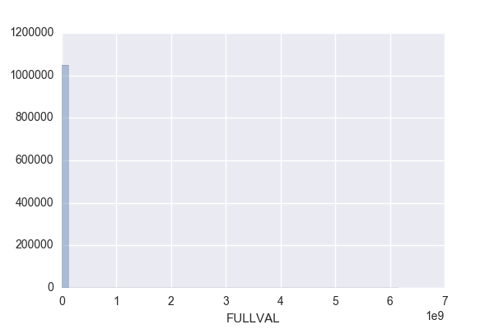
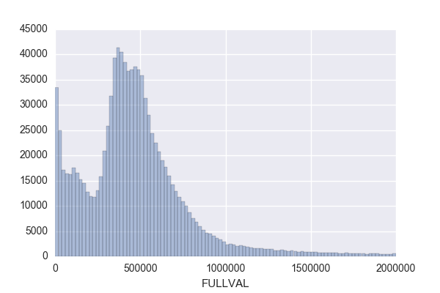
How to Look at a Numeric Field
Calculate the basic statistical properties
% populated, mean, standard deviation, max, min
Look at the distribution
This picture doesn’t show a lot of information
This picture is much better. It shows the nature of the distribution.

Slide 27
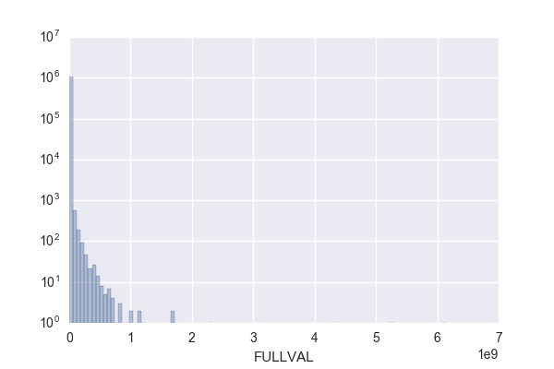
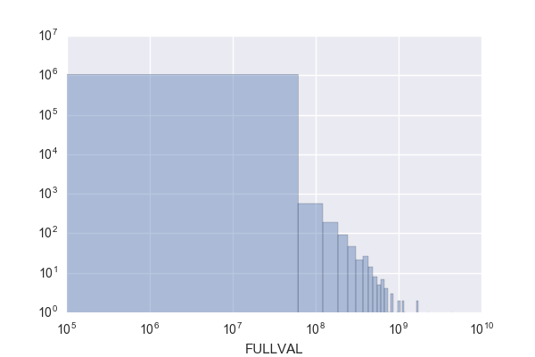
Use Good Choices of Ranges and Logs for Plots
First try, not good
Try a log y axis
Better choice of x range
Or a log log scale

Slide 28
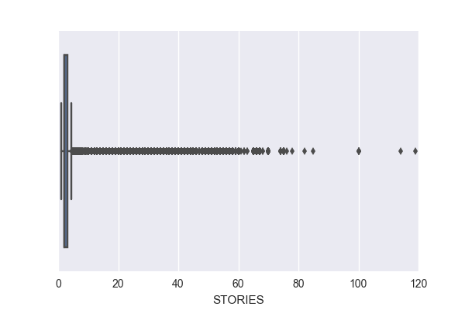
Can Start With a Boxplot for a Numeric Distribution
If your data has a difficult distribution, for example bad outliers, it’s sometimes hard to find a good scale. Try starting with a ”boxplot”
25% quartile through the 75% quartile
minimum
“maximum”
outliers

Slide 29
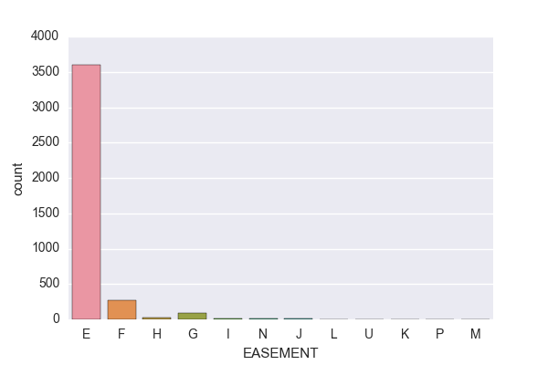
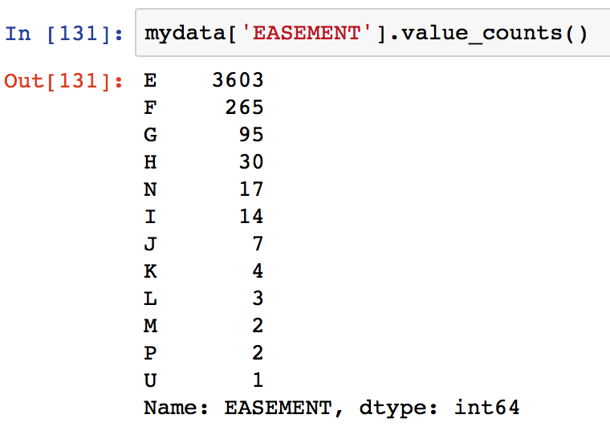
How to Look at a Categorical Field
Calculate the basic statistical properties
% populated, number of unique values
Look at the distribution, either as a histogram or a table

Slide 30
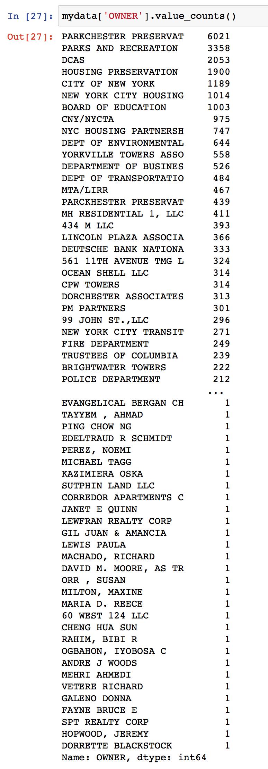
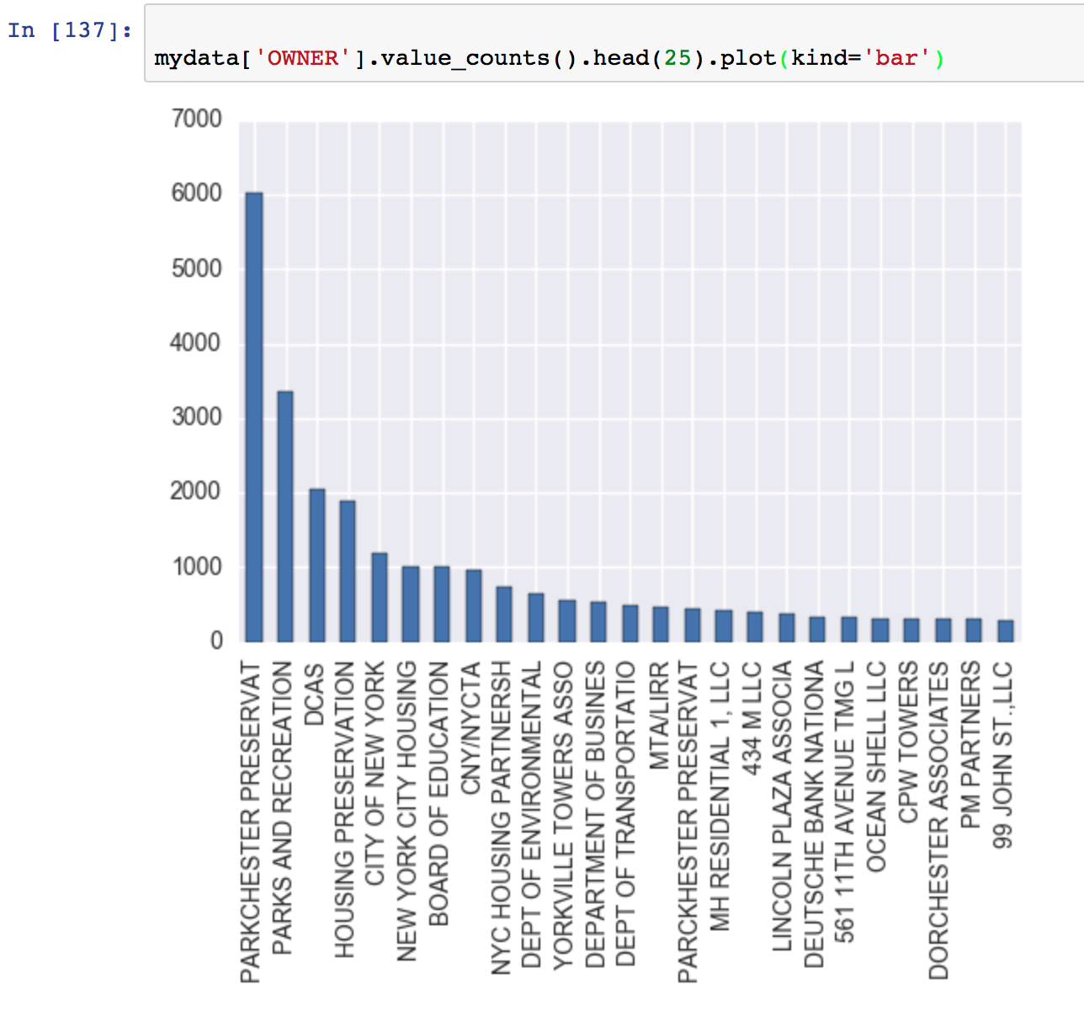
How to Look at a Long Categorical Field
You can print a partial list or a histogram of the top n values

Slide 31
Look At Project 1 Data
Homework 2:
Find 3 interesting/unusual things about Project 1 data
Due 1/25 noon
Here is a little information about the data for our homework and that we will be using for our first project. I don’t know much about the data. I found it here:
https://data.cityofnewyork.us/Housing-Development/Property-Valuation-and-Assessment-Data/rgy2-tti8
As far as I can tell
BBLE is a concatenation of 3 fields: BORO, BLOCK, LOT
AV abbreviation means Assessed Value
LT abbreviation means Lot
BLD abbreviation means Building

